Slide 1
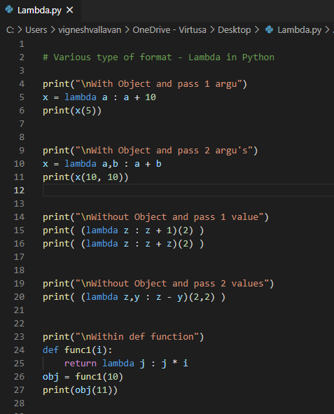
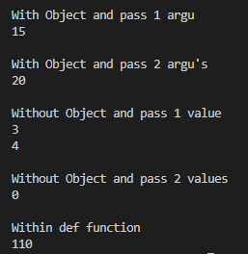
Python - Lambda
Lambda - one line function of python code
def keyword --> Normal functions
lambda keyword --> Anonymous functions

